Slide 1
Lecture 14 ETHERNET, CARRIER SENSE MULTIPLE ACCESS WITH COLLISION DETECTION (CSMA/CD)
Ethernet is a physical and data link layer technology used for local area networks ( LANs). This transmission medium was first widely used in the 1980s. It supported a maximum theoretical data of 10 mega bits per second (10 M bps) then.

Slide 2
Fast Ethernet standards increased this maximum data rate to 100 Mbps. At present, the Gigabit Ethernet technology further extends peak performances to 1000 Mbps. High level network protocols like Internet Protocol(IP) use Ethernet as their transmission medium. Data travels over the Ethernet inside protocol units called frames.

Slide 3
Carrier Sense Multiple Access (CSMA)
CSMA is a probabilistic media access control (MAC) protocol in which a node verifies the absence of other traffic before transmitting its own data on a shared transmission medium, such as electrical bus or band of electromagnetic waves.
Carrier sense means that a transmitter uses feedback from a receiver to determine whether another transmission is in progress, or not before initiating a transmission. It tries to detect the presence of a carrier wave from another station before attempting to transmit.

Slide 4
If a carrier is sensed, the station waits for transmission in progress to finish before initiating its own transmission.
Multiple access means multiple stations send and receive on the same medium (shared medium). Transmission by one station (node) is generally received by all other stations (nodes) connected to the medium. Consider he diagram below:

Slide 5
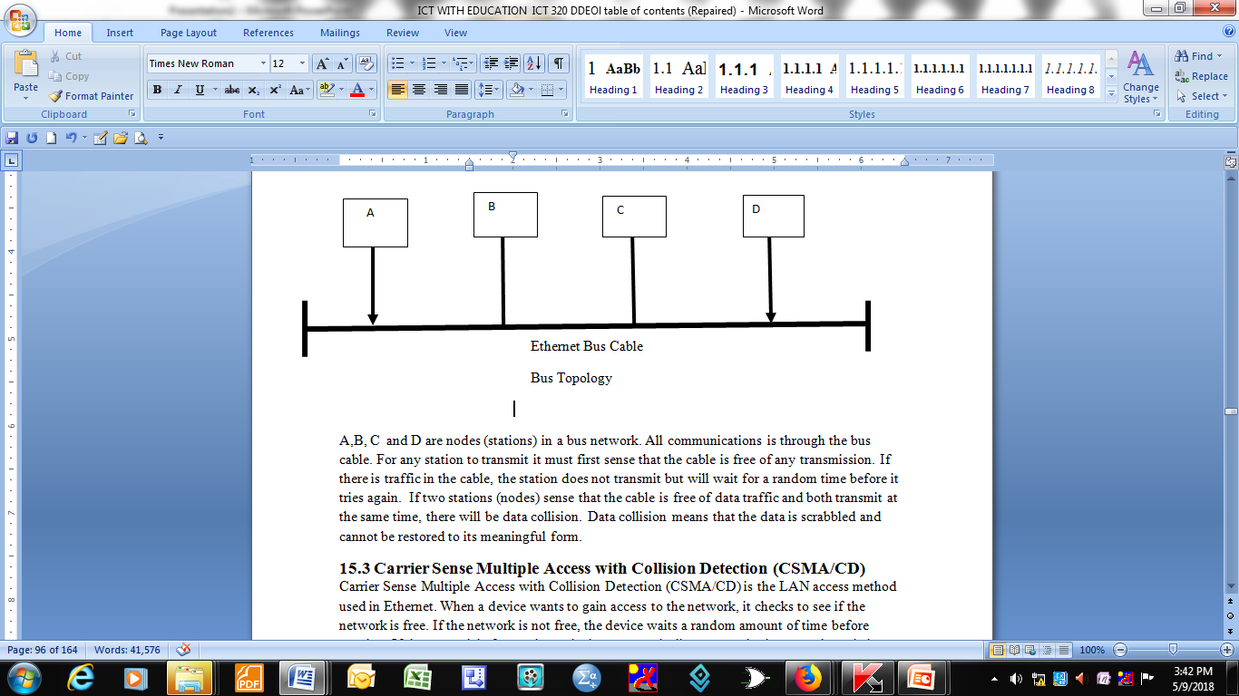
Linear Bus Topology

Slide 6
Explanation
A,B, C and D are nodes (stations) in a bus network. All communications is through the bus cable.
For any station to transmit it must first sense that the cable is free of any transmission.
If there is traffic in the cable, the station does not transmit but will wait for a random time before it tries again.
If two stations (nodes) sense that the cable is free of data traffic and both transmit at the same time, there will be data collision. Data collision means that the data is scrabbled and cannot be restored to its meaningful form.

Slide 7
Carrier Sense Multiple Access with Collision Detection (CSMA/CD)
Carrier Sense Multiple Access with Collision Detection (CSMA/CD) is the LAN access method used in Ethernet.
When a device wants to gain access to the network, it checks to see if the network is free. If the network is not free, the device waits a random amount of time before retrying.
If the network is free and two devices access the line at exactly the same time, their signals collide.

Slide 8
When the collision is detected, they both back off and wait a random amount of time before retrying.
Both stations transmit a jamming signal to warn other active stations that there has been data collision. The jamming signal is 48 bits. In response to the jamming signal each transmitting station stops transmitting and uses a binary exponential back off algorithm to wait before attempting to transmit again.

Slide 9
Each station waits for s random amount of time before starting the whole process again, beginning with sensing process.
If a station’s subsequent attempt results in another collision, its random wait time will be doubled.
The process may be repeated up to 16 times, after which the station, if still unsuccessful, reports a transmission error to the higher protocol layers.

Slide 10
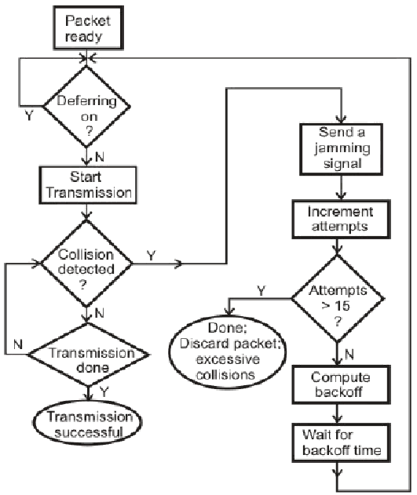
Simplified operation of the CSMA/CD protocol

Slide 11
Probability of collisions
The probability of a collision occurring is proportional to:
Number of stations
Frequency of transmissions
Size of frames
Length of the LAN

Slide 12
Ethernet and the IEEE 802.3 standards states that
to be able to detect collisions
a transmitting station should monitor the network for a period of time called the slot time.
A slot time, is the duration which a collision may occur and it is the maximum time duration for a signal to reach the other far end of the network and for a collision to propagate back. The slot time is defined to be 51.2 microseconds (512 bit times in a 10 M bps LAN).

Slide 13
This time also imposes a maximum length of the size of the network.
It also imposes a minimum (64 bytes excluding the preamble and SYN) on the size of the frames transmitted by each station.

Slide 14
Ethernet and IEEE 802.3 frame formats
The Ethernet and IEEE frame formats are not the same but both protocols use the same transmission medium and access method.
LAN stations running on these protocols could share a common bus but cannot communicate with each other.

Slide 15
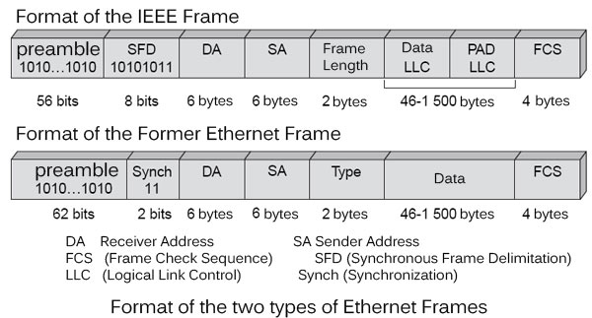
Ethernet frame format

Slide 16
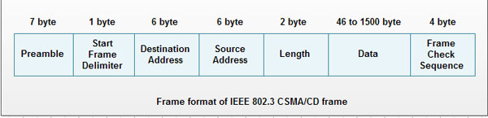
IEEE frame format 802.3 CSMA/CD

Slide 17
Explanation to the Ethernet frame fields
The 62 preamble bits allow the physical layer signalling circuitry to synchronize the receive frame timing circuitry
The 2 bits SYNC (synchronize) indicate that the data portion of the frame will follow.
DA is the destination address, SA is the source address, TYPE field identifies the higher layer protocol which is used, and DATA field is the payload. The frame check sequence is the cyclic redundancy check code used to detect the presence of errors (if any) during transmission.

Slide 18
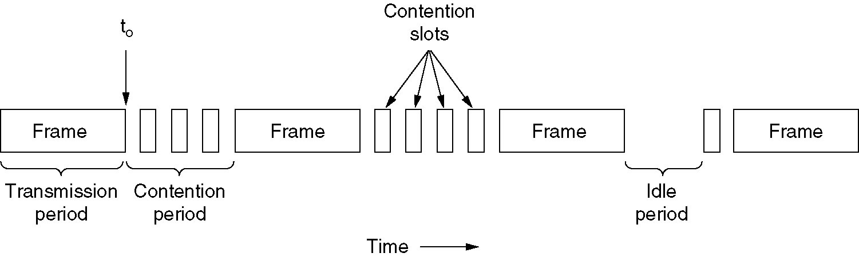
Binary Exponential back off algorithm

Slide 19
CSMA/CD Protocol possible states
The CSMA/CD Protocol can be in one of three possible states:
Contention
Transmission
Idle

Slide 20
Operation of the binary exponential backoff algorithm
At time t_{o} a station that was transmitting its frame has just finished.
Any other station that has data (frames) to transmit can now enter the contention period to try to gain access of the transmission medium.
If two stations sense that the channel is free and start transmitting at the same time, there will be packet (data) collision.

Slide 21
The binary exponential back off algorithm operates as follows:
When a collision is detected the sender generates a noise burst (jam signal) to ensure all active stations recognize the condition and aborts transmission
Waits for 0 or 1 contention period (2Ʈ, i.e. 2 end to end propagation time) before attempting transmission again
If another collision is detected waits for 0, 1, 2, or 3 contention periods

Slide 22
In general wait between 0 and 2^{r}- 1 contention periods where r is the number of collisions encountered
Finally, free interval at 1023 contentions periods after 10 attempts and give up (report transmission failure) after 16 attempts.

Slide 23
Collision time slices
K = {0, 1} 1st collision
K = {0, 1, 2, 3) 2nd collision
K = {0, 1, 2, 3, 4, 5, 6, 7) 3rd collision
After 10 or more collisions K = {0, 1, 2, 3,………..1023}. The slots K are chosen with equal probability. It clear from the size of sets from which K is chosen grows exponentially with the number of collisions (until n = 10).

